Slide 1


Data Analytics
Presentation
Presentation

Slide 2


Today's agenda
Project recap
Problem
The Analytics team
Process
Insights
Summary

Slide 3

Social Buzz is a fast growing technolgoy unicorn that need to adapt qucikyly to its global scale.
Accenture comes in to handle these tasks for 3 months;
- An audit of their big data practice
- Recommendations for a successful IPO
- An analysis of their content categories that highlights the top 5 categories with the largest aggregate popularity
Project Recap

Slide 4


Problem
Over 100000 posts per day
36 500000 pieces of content per year

Slide 5



The Analytics team

Slide 6
Data understanding
1
Data cleaning
2
Data Modeling
3
Data Analysis
4
5
Uncover insights

Slide 7

Insights
Most post in Jan
animals is the
most popular content
Culture is the last popular

Slide 8
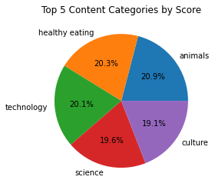
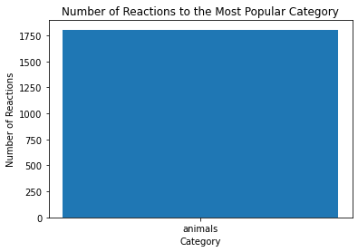

Slide 9
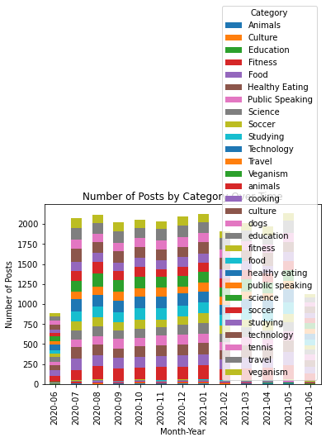
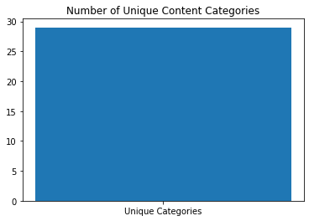

Slide 10

Summary

Slide 11

Thank you!
ANY QUESTIONS?

